Slide 1
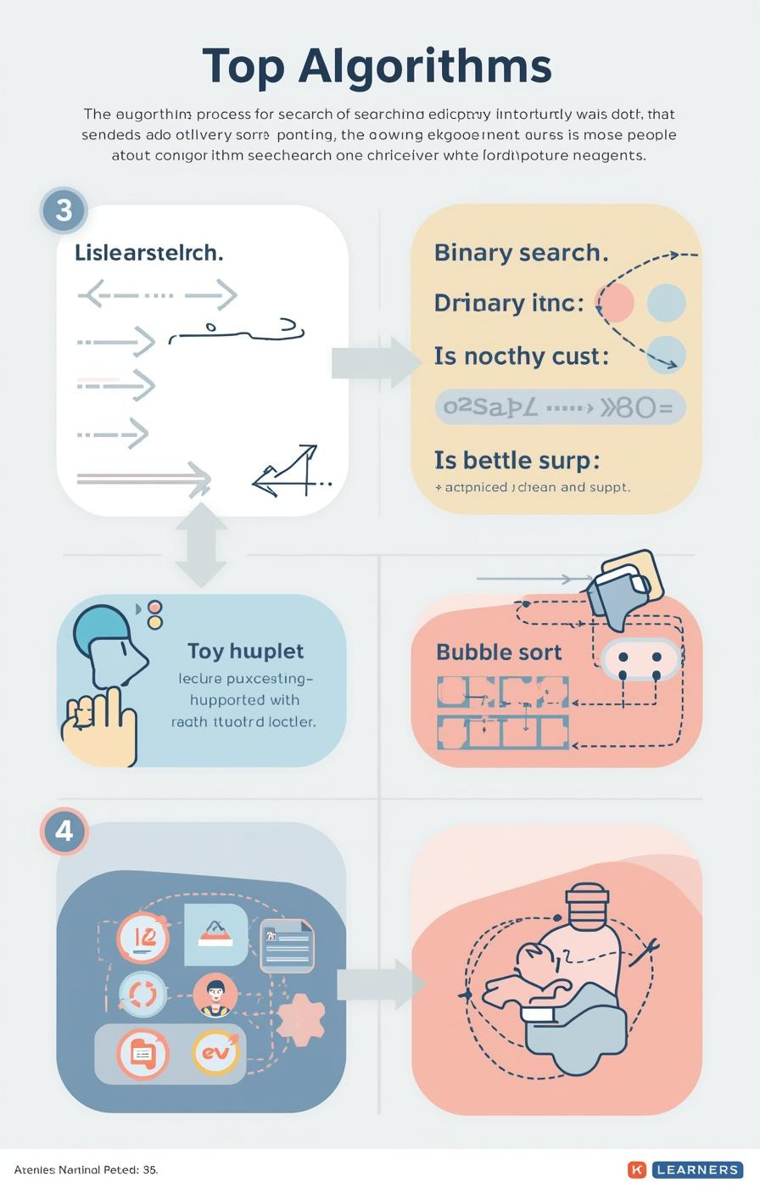

Algorithms: Searching and Sorting
by Mr. Edward Paul

Slide 2

Understanding Algorithms
Their Importance in Computer Science
Algorithms are essential, defined as step-by-step procedures for solving problems. They enable computers to efficiently process information, making them a fundamental aspect of computer science and programming.
2

Slide 3

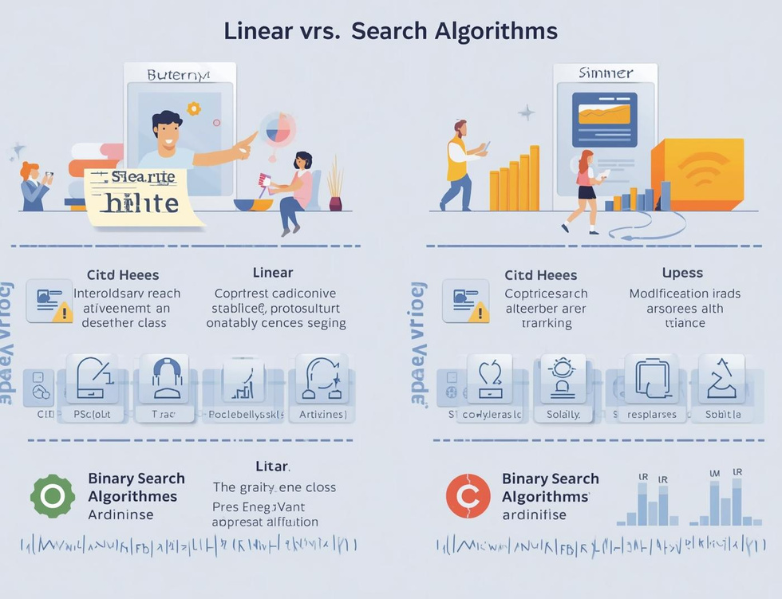
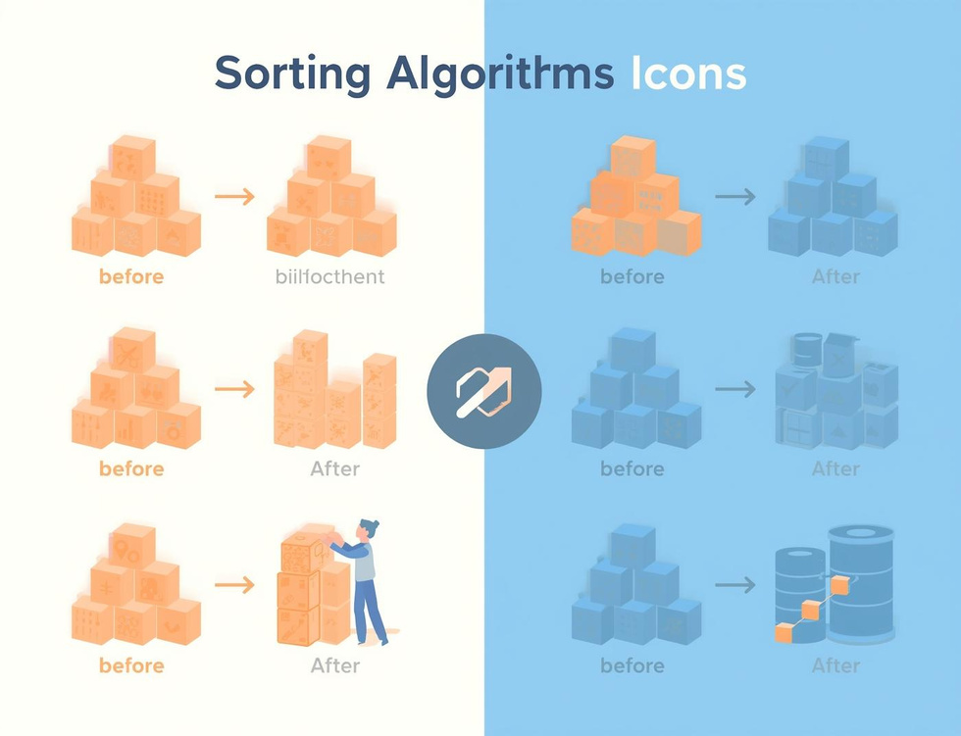
Learning Objectives
Search Algorithms
Compare Efficiencies
Bubble Sort
Understand how algorithms locate data effectively through different searching techniques.
Learn the efficiency differences between linear and binary search methods in data retrieval.
Understand the basics of bubble sort and how it organizes data through comparisons.

Slide 4
Linear Search
Sequential Scanning for Data Retrieval
Definition
Simple Mechanism
Use Cases
Linear search is a straightforward algorithm that checks each element in a list sequentially until it finds the target value or reaches the end of the list.
This method is easy to implement but can be inefficient for large datasets, as it might require examining every single item before locating the desired information.
Linear search is particularly useful for small or unsorted datasets where quick implementation is necessary, making it an ideal choice for simple search tasks.
4

Slide 5
Binary Search
Divide and Conquer Method Explained
Definition
Mechanism
Requirements
Binary search is a fast search algorithm that finds the position of a target value within a sorted array, using a divide-and-conquer strategy for efficiency.
The algorithm repeatedly divides the search interval in half; comparing the target value to the middle element, it narrows down the potential location until the target is found.
For binary search to work, the data must be sorted beforehand; this prerequisite allows the algorithm to efficiently eliminate half of the remaining elements with each comparison.
5

Slide 6
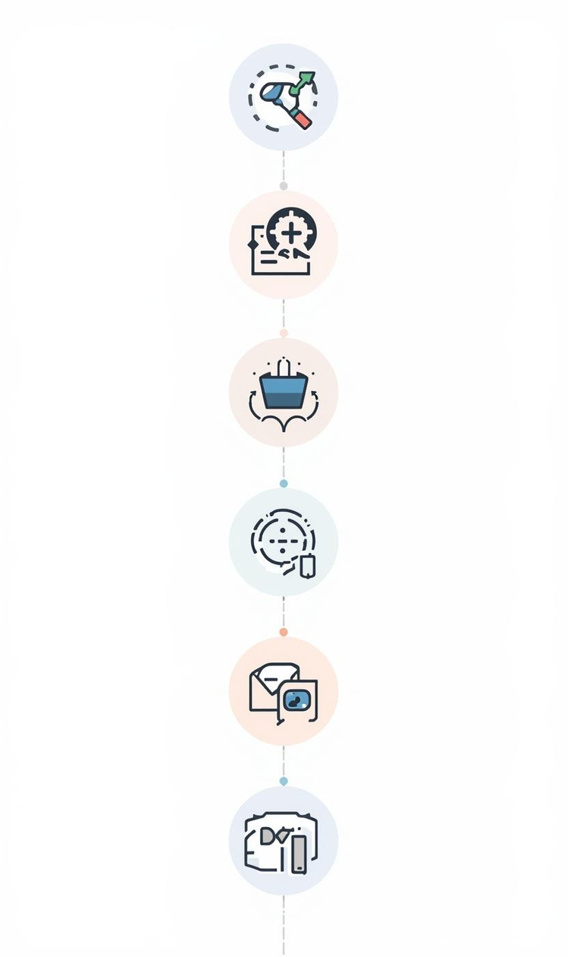
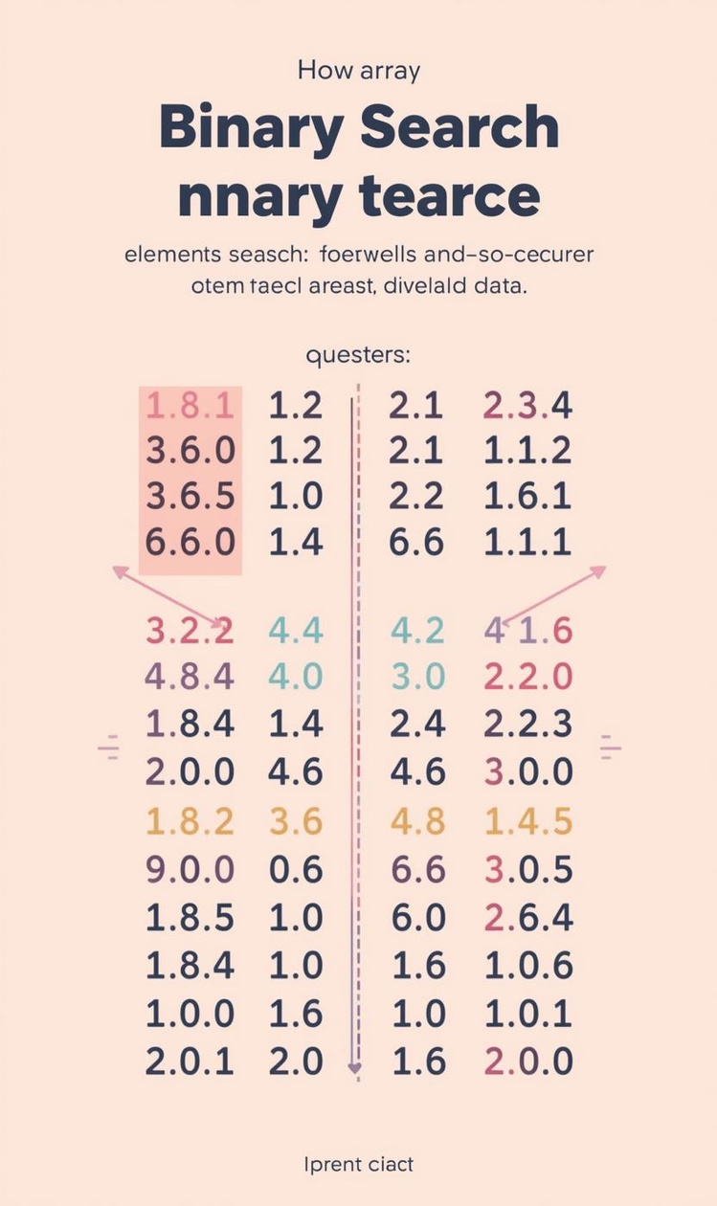

Comparing Efficiency of Search Algorithms
Efficiency
Pros and Cons
Linear search has O(n) time complexity.
Binary search is faster but needs sorted data.

Slide 7
Algorithm Tracing
Linear Search
Binary Search
Efficiency Comparison
In linear search, each element is examined sequentially until the target is found. This straightforward approach is effective for small or unsorted datasets, but can be slow for larger lists.
Binary search requires a sorted list, dividing the search space in half repeatedly, which drastically reduces the number of checks needed to find the target value, making it more efficient than linear search.
Comparing the two searches, linear search has a time complexity of O(n), while binary search operates at O(log n), highlighting the significant efficiency gained through the divide-and-conquer strategy of binary search.

Slide 8
Bubble Sort
Introducing Sorting Algorithms and Their Importance
8

Slide 9
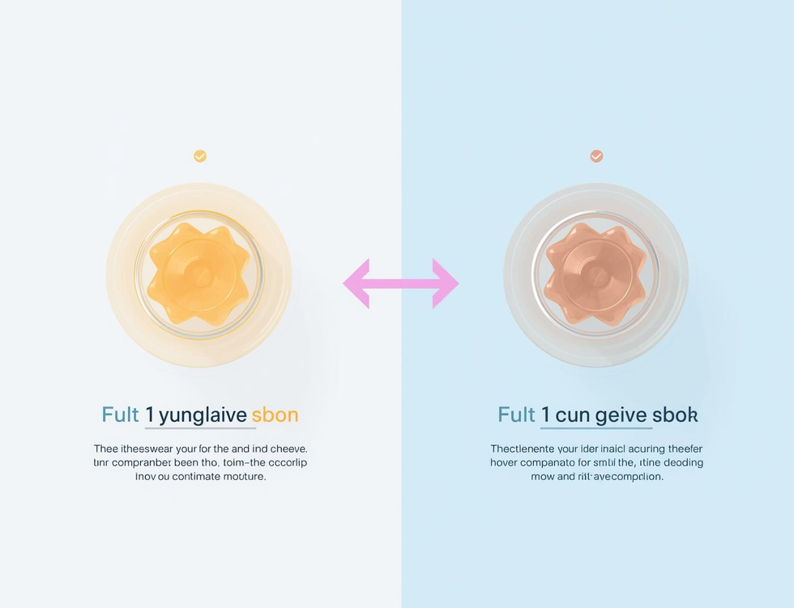
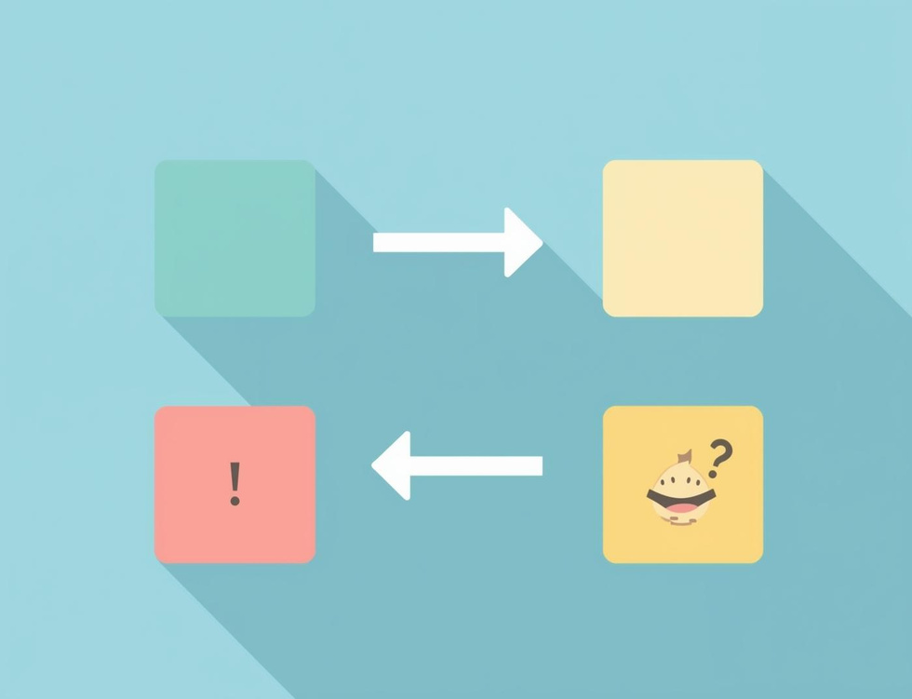
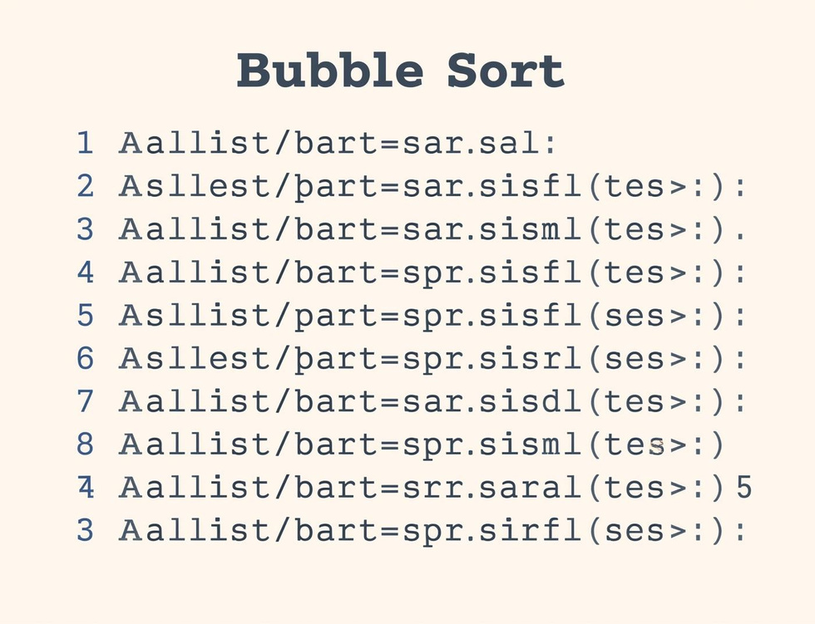
Bubble Sort Steps
Compare Elements
Swap if Needed
Repeat Passes
Compare adjacent elements to determine if they need swapping for sorting.
Elements are swapped if they are in the wrong order, ensuring sorting progress.
The sorting process continues with repeated passes until the entire list is sorted.

Slide 10

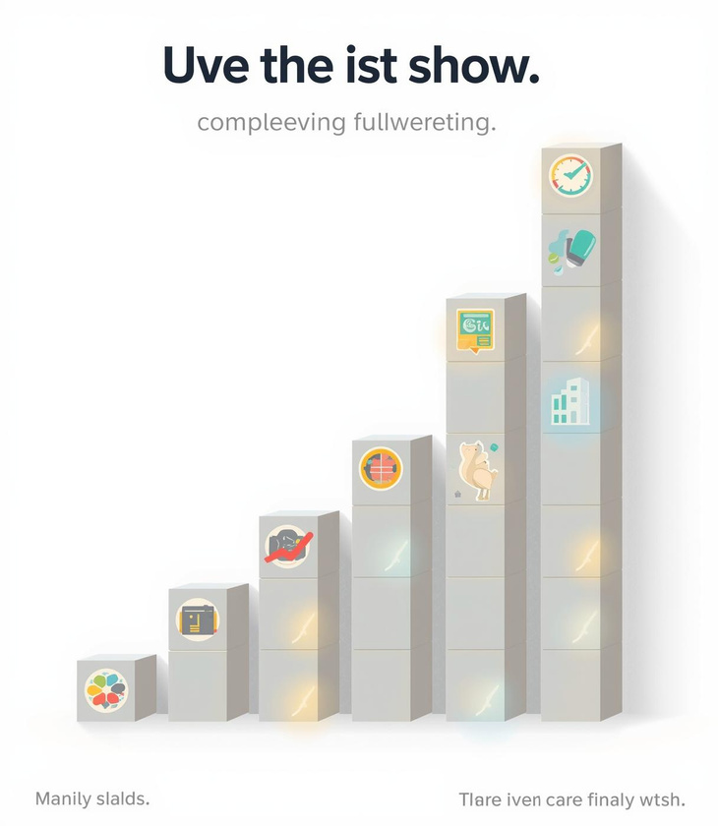
Tracing Bubble Sort Steps

Slide 11
Key Takeaways and Insights
01
Search Algorithms
Linear and binary searches each have distinct strengths.
02
Sorting Concepts
Bubble sort is an essential foundational sorting algorithm.
03
Tracing Importance
Understanding algorithms requires step-by-step tracing practice.

Slide 12

Continue Learning
Practice tracing algorithms today!

Slide 13
This lesson pack is designed for a high school physics class (e.g., Grades 9-10)
---
## Detailed Lesson Pack: Force in Physics
**Topic:** Force in Physics: Push, Pull, and Power!
**Estimated Time:** 60-75 minutes (can be extended with more activities/discussion)
---
### 1. Lesson Objectives
By the end of this lesson, students will be able to:
* **Define** force as a push or pull and identify its standard unit (Newton).
* **Distinguish** between contact and non-contact forces, providing examples of each.
* **Describe** the various effects of forces on objects (change motion, speed, direction, shape).
* **Explain** that force is a vector quantity, possessing both magnitude and direction.
* **Calculate** the net (resultant) force acting on an object in one dimension.
* **Differentiate** between balanced and unbalanced forces and predict their impact on an object's motion.
### 2. Introduction / Starter Activity
**Title:** "Push, Pull, and Everything In Between!" (5-7 minutes)
**Activity:** Force Brainstorm & Picture Analysis

Slide 14
**Display Images:** Show a series of diverse images on the screen (or printouts)
* A person pushing a shopping cart.
* An apple falling from a tree.
* A magnet attracting paperclips.
* A car braking to a stop.
* Two teams in a tug-of-war.
* A person kicking a soccer ball.

Slide 15
**Engage:** Ask students: "What do all these pictures have in common?" (Encourag

Slide 16
**Guide:** Gently guide their responses towards the idea of "something acting on

Slide 17
**Introduce Term:** "Scientifically, we call these pushes and pulls **FORCES**."

Slide 18
**Quick Poll/Discussion:** "What comes to mind when you hear the word 'force'?"
### 3. Key Teaching Points
(Approx. 20-25 minutes)

Slide 19
**What is Force?**
* **Definition:** A push or a pull that can cause an object to accelerate (change its velocity), deform, or change direction.
* **Unit:** **Newton (N)**, named after Sir Isaac Newton. Explain it's a derived unit. Analogy: 1 Newton is roughly the force needed to hold up a small apple (approx. 100g) against gravity.
* **Symbol:** F (often with a subscript, e.g., Fg for gravitational force).

Slide 20
**Force as a Vector Quantity:**
* Forces have both **magnitude** (how strong the push/pull is) and **direction** (which way it's pushing/pulling).
* **Visual Representation:** Introduce arrows as the standard way to represent forces. The length of the arrow indicates magnitude, and the arrowhead indicates direction. Emphasize that direction is crucial.

Slide 21
**Types of Forces:**
* **Contact Forces:** Act when objects are physically touching.
* *Applied Force (Fapp):* Direct push or pull on an object.
* *Friction (Ff):* Force that opposes motion between surfaces in contact.
* *Normal Force (Fn):* The support force exerted by a surface perpendicular to it, preventing an object from passing through.
* *Tension (Ft):* The pulling force transmitted axially through a string, rope, cable, or similar one-dimensional continuous object.
* *Air Resistance (Fair):* A type of frictional force opposing the motion of an object through air.
* **Non-Contact Forces (Field Forces):** Act over a distance without physical contact.
* *Gravitational Force (Fg):* The attractive force between any two objects with mass (e.g., Earth pulling an apple down).
* *Magnetic Force (Fmag):* Attraction or repulsion between magnets or magnetic materials.
* *Electrostatic Force (Fe):* Attraction or repulsion between electrically charged objects.
* *(Optional: Use real-world examples or quick demos for each type).*

Slide 22
**Effects of Forces:** Forces can:
* **Start motion:** (e.g., kicking a stationary soccer ball).
* **Stop motion:** (e.g., a catcher catching a baseball).
* **Change the speed of an object:** (e.g., pressing the accelerator or brake in a car).
* **Change the direction of an object:** (e.g., a tennis racket hitting a ball).
* **Change the shape or size of an object:** (e.g., crushing a soda can, stretching a spring).

Slide 23
**Net Force (Resultant Force):**
* **Definition:** The single, overall force acting on an object, considering all individual forces and their directions.
* **Calculation:** Forces in the same direction add up; forces in opposite directions subtract.
* **Balanced Forces:** When the net force is zero (F_net = 0 N).
* **Result:** If the object is at rest, it remains at rest. If the object is moving, it continues to move at a constant velocity (constant speed in a straight line). Briefly mention this is related to **inertia** (Newton's First Law).
* **Unbalanced Forces:** When the net force is greater than zero (F_net ≠ 0 N).
* **Result:** The object will **accelerate** (change its velocity – speed up, slow down, or change direction). This sets the stage for Newton's Second Law.
### 4. Guided Practice / Class Activities
(Approx. 25-30 minutes)
**Activity 1: Force Identification & Categorization (Individual/Pairs)**
* **Task:** Provide students with a worksheet or projected scenarios. For each scenario, they must identify 1-2 forces present and categorize them as contact or non-contact.
* **Scenarios:**

Slide 24
A book resting on a table. (Normal, Gravity)

Slide 25
An apple falling from a tree. (Gravity, Air Resistance)

Slide 26
A person pushing a car that won't start. (Applied, Friction, Gravity, Normal)

Slide 27
A magnet lifting a paperclip. (Magnetic, Gravity)
* **Engagement:** Circulate, provide immediate feedback, and encourage discussion in pairs.
**Activity 2: "Tug-of-War" Net Force Simulation (Whole Class/Small Groups)**
* **Setup:** Use a rope or simply designate two areas on the floor. Have 2-3 student volunteers act as "teams" pulling in opposite directions.
* **Scenario 1 (Balanced):** "Team A pulls with 100N, Team B pulls with 100N." Ask: "What is the net force? What happens to the rope?" (Fnet = 0, rope doesn't move/moves at constant velocity if already moving).
* **Scenario 2 (Unbalanced):** "Team A pulls with 120N, Team B pulls with 80N." Ask: "What is the net force? Who wins? Which way does the rope accelerate?" (Fnet = 40N towards Team A, rope accelerates towards Team A).
* **Discussion:** Reinforce the concepts of balanced and unbalanced forces with a physical demonstration. Discuss how to calculate the net force.
**Activity 3: Drawing & Calculating Net Force (Worksheet/Whiteboard Practice)**
* **Task:** Provide students with simple diagrams showing an object with forces acting on it in one dimension. Students draw the force vectors (arrows) and calculate the net force. Then, they state whether the forces are balanced or unbalanced and predict the object's motion.
* **Examples:**

Slide 28
A box pushed by F1 = 50 N (right) and F2 = 30 N (right). (Net F = 80N right, unb

Slide 29
A box pushed by F1 = 70 N (right) and F2 = 70 N (left). (Net F = 0N, balanced, a

Slide 30
A box pulled by F1 = 60 N (right) and F2 = 20 N (left). (Net F = 40N right, unba

Slide 31
A balloon floating upwards with a lift force of 30N and gravity pulling down wit
* **Engagement:** Use mini-whiteboards for quick checks, or have students work on a worksheet. Review answers as a class.
### 5. Assessment Ideas
**Formative (During Lesson):**
* **Thumbs Up/Down/Sideways:** After explaining a concept (e.g., balanced vs. unbalanced), ask students to show their understanding.
* **Mini Whiteboards:** Pose a quick question (e.g., "What is the unit of force?" or "Calculate the net force: 20N left, 5N right") and have students hold up their answers.
* **Think-Pair-Share:** Ask a probing question like, "Why do you need to keep pedaling a bike to maintain constant speed on flat ground, even though constant velocity implies zero net force?" (To overcome friction and air resistance).
* **Observation:** Monitor student participation, engagement, and accuracy during activities and discussions.
**Summative (After Lesson / Homework):**
* **Short Quiz:**
* Multiple-choice questions on definitions, types of forces.
* Short-answer questions explaining vector nature or effects of forces.
* 2-3 problems requiring calculation of net force and prediction of motion.
* **Problem-Solving Worksheet:** A set of 5-7 problems requiring students to identify forces, draw simple force diagrams (if introduced), calculate net force, and describe the resulting motion.
* **"Force Story" Challenge:** Students choose an everyday activity (e.g., throwing a ball, sitting on a chair, opening a door) and write a short paragraph or draw a storyboard explaining at least three different forces involved and their effects.
### 6. Summary / Conclusion
(Approx. 5-7 minutes)

Slide 32
**Recap Key Points:** "Today, we've explored the fundamental concept of force. W

Slide 33
**Key Takeaways (Q&A style):**
* "What's the main difference between a contact and a non-contact force?"
* "If an object has a net force of zero, what can you say about its motion?"
* "Why is knowing the direction of a force just as important as knowing its magnitude?"

Slide 34
**Real-World Connection:** "Forces are everywhere around us, constantly influenc

Slide 35
**Looking Ahead:** "Next time, we'll delve deeper into how unbalanced forces cau
### 7. PowerPoint Slide Outline
**Slide 1: Title Slide**
* **Title:** Force in Physics: Push, Pull, and Power!
* **Subtitle:** Understanding the Fundamentals of Motion
* **Image:** Dynamic collage of various forces (e.g., person pushing a box, magnet, gravity, tug-of-war).
**Slide 2: Lesson Objectives**
* **Title:** What Will We Learn Today?
* **Bullet Points:**
* Define force and its unit (Newton).
* Distinguish between contact and non-contact forces.
* Describe the effects of forces on objects.
* Explain force as a vector quantity.
* Calculate net (resultant) force in one dimension.
* Differentiate between balanced and unbalanced forces.
**Slide 3: Introduction / Starter Activity**
* **Title:** Push, Pull, and Everything In Between!
* **Activity:** Force Brainstorm & Picture Analysis
* **Instructions:** Look at the images. What do they have in common? What word describes these actions?
* **Images:** Shopping cart, falling apple, magnet, car braking, tug-of-war, kicking ball.
* **Prompt:** What comes to mind when you hear "force"?
**Slide 4: What is Force?**
* **Title:** Defining Force
* **Bullet Points:**
* A **push** or a **pull**.
* Causes an object to **accelerate**, **deform**, or **change direction**.
* **Unit:** **Newton (N)**, named after Sir Isaac Newton. (1N ≈ holds 100g apple).
* **Symbol:** F
**Slide 5: Force as a Vector**
* **Title:** More Than Just Strength: Direction Matters!
* **Bullet Points:**
* Force is a **vector quantity**.
* Has both **magnitude** (how strong) and **direction** (which way).
* **Visual:** Represented by an **arrow**.
* Length of arrow = magnitude.
* Arrowhead = direction.
* **Image:** Arrows of different lengths and directions on a grid.
**Slide 6: Types of Forces (Part 1: Contact Forces)**
* **Title:** Getting in Touch: Contact Forces
* **Bullet Points:**
* Act when objects are **physically touching**.
* **Examples:**
* **Applied Force (Fapp):** Direct push/pull.
* **Friction (Ff):** Opposes motion.
* **Normal Force (Fn):** Surface support (perpendicular).
* **Tension (Ft):** Pull through rope/cable.
* **Air Resistance (Fair):** Opposes motion through air.
* **Images:** Simple diagrams illustrating each contact force.
**Slide 7: Types of Forces (Part 2: Non-Contact Forces)**
* **Title:** Forces from Afar: Non-Contact Forces (Field Forces)
* **Bullet Points:**
* Act over a **distance** without physical contact.
* **Examples:**
* **Gravitational Force (Fg):** Attraction due to mass (e.g., Earth's gravity).
* **Magnetic Force (Fmag):** Attraction/repulsion between magnets.
* **Electrostatic Force (Fe):** Attraction/repulsion between charged objects.
* **Images:** Simple diagrams illustrating each non-contact force.
**Slide 8: Effects of Forces**
* **Title:** What Can Forces Do?
* **Bullet Points:** Forces can...
* **Start** motion.
* **Stop** motion.
* **Change speed** (accelerate/decelerate).
* **Change direction**.
* **Change shape/size**.
* **Images:** Visual examples for each effect.
**Slide 9: Net Force: The Big Picture**
* **Title:** Net Force: The Overall Push or Pull
* **Bullet Points:**
* The **overall (resultant)** force acting on an object.
* Determines an object's change in motion.
* Calculated by combining all individual forces (considering direction!).
* **Image:** A block with multiple force arrows acting on it (illustrating combination).
**Slide 10: Balanced Forces**
* **Title:** When Forces Cancel Out: Balanced Forces
* **Bullet Points:**
* **Net Force = Zero (0 N).**
* **Result:**
* Object at rest stays at rest.
* Object moving continues at **constant velocity** (constant speed in a straight line).
* **Concept:** Related to **inertia** (Newton's 1st Law).
* **Image:** Tug-of-war with equal forces, book on a table.
**Slide 11: Unbalanced Forces**
* **Title:** When Forces Win: Unbalanced Forces
* **Bullet Points:**
* **Net Force ≠ Zero (not 0 N).**
* **Result:** The object will **accelerate** (change its velocity – speed up, slow down, or change direction).
* **Future Link:** Leads to Newton's Second Law (F=ma).
* **Image:** Tug-of-war with unequal forces, person pushing a moving box.
**Slide 12: Guided Practice 1: Force Identification**
* **Title:** Activity: Spot the Forces!
* **Instructions:** For each scenario, identify the forces present and state if they are contact or non-contact.
* **Scenarios (Text/Image):** Book on table, falling apple, magnet & paperclip, braking car.
**Slide 13: Guided Practice 2: Tug-of-War Simulation**
* **Title:** Class Activity: The Net Force Tug-of-War!
* **Instructions:** (Teacher-led). Let's simulate tug-of-war. Calculate the net force and predict motion.
* **Scenarios:** Team A=100N, Team B=80N; Team A=120N, Team B=120N; Team A=70N, Team B=90N.
* **Visual:** Simple diagram of a rope with force arrows.
**Slide 14: Guided Practice 3: Calculating Net Force**
* **Title:** Practice Time: Calculate the Net Force!
* **Instructions:** For each object, calculate the net force and state the resulting motion.
* **Problems (Diagrams with forces):**
* Box: 20N (R), 15N (R)
* Box: 40N (R), 40N (L)
* Box: 60N (R), 20N (L)
* Balloon: 30N (U), 20N (D)
**Slide 15: Assessment Ideas**
* **Title:** How Do We Know We've Got It?
* **Bullet Points:**
* **Formative:** Thumbs Up/Down, Mini-whiteboards, Think-Pair-Share, Observation.
* **Summative:** Short Quiz, Problem-Solving Worksheet, "Force Story" Challenge.
**Slide 16: Summary / Conclusion**
* **Title:** Forces: A Recap!
* **Bullet Points:**
* Force = push/pull (Newtons, vector).
* Types: Contact (friction, normal) & Non-contact (gravity, magnetic).
* Effects: Change motion, speed, direction, shape.
* Net Force: Overall force.
* Balanced Forces (Net F = 0): No acceleration.
* Unbalanced Forces (Net F ≠ 0): Causes acceleration.
* **Question:** What was the most interesting thing you learned today?
**Slide 17: Looking Ahead & Questions**
* **Title:** What's Next? & Your Questions!
* **Bullet Points:**
* Next Lesson: Newton's Laws of Motion (especially F=ma!).
* Think about: How does force affect *how much* an object accelerates?
* **Prompt:** Any questions about Force?
* **Image:** A thought bubble or question mark.

